Slide 1
An Analysis of Speed Dating data
Team SPEED (3)
Cody Bassett, Nicholas Erdos-Thayer, Tommy Hvidhyld, Kathleen Pflugi

Slide 2
What we’ll look at:
Source: Kaggle
Commence analysis
The preferred method when looking at this data was Exploratory Analysis.
We are going to look at what factors impact attributes ratings and how likely people will be matched while speed dating.

Slide 3
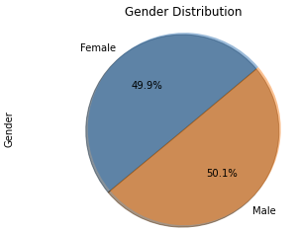
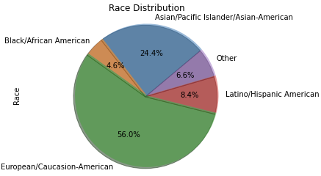
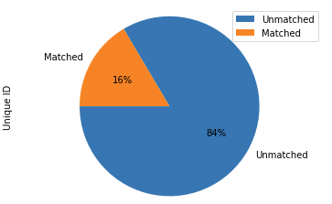
Introductory Statistics
17 events in 2002-2003
449 Participants
College campuses around the world

Slide 4
Matched vs Unmatched Attribute Ratings
Question 1: Of the total participants, how do matched participants rate themselves compare to the ratings they gave their matched partners and how do those ratings compare to participants who did not match and their partner ratings?
Summary:
Matched participants rated partners high, as expected
Favorably overall but particularly in attractiveness
Unmatched participants rated themselves higher, most notably in intelligence
Matched and unmatched participants rated themselves similarly across all attributes

Slide 5
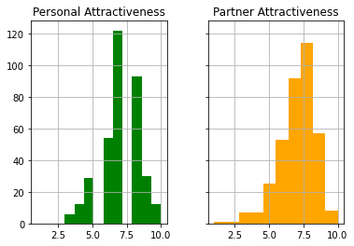
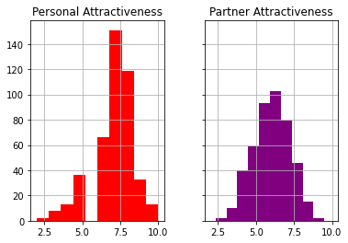
Attractiveness Ratings
Key Takeaways
Matched participants rated their partners more frequently as more attractive than themselves
Unmatched participants rated themselves most frequently around a 7 and rated their partners lower with the majority occurring around a 6
Matched
Unmatched

Slide 6
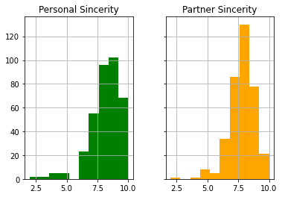
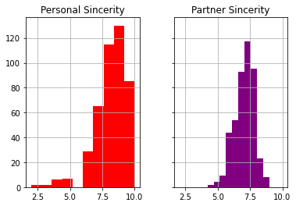
Sincerity Ratings
Key Takeaways
Matched participants rated themselves high in sincerity and rated their partners more frequently at an 8
Unmatched participants also gave themselves high scores in sincerity but rated their partners less so, with the highest frequency occurring around a 7
Matched
Unmatched

Slide 7
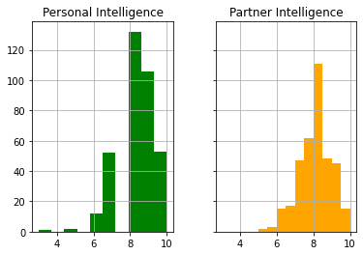
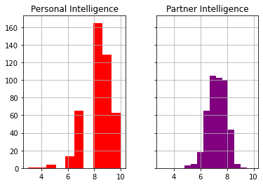
Intelligence Ratings
Key Takeaways
Matched participants rated themselves very high in intelligence and rated their partners less frequently as high
Unmatched participants also rated themselves very high in intelligence but were not as favorable in ratings for their partners
Matched
Unmatched

Slide 8
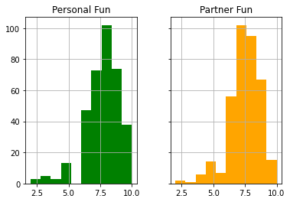
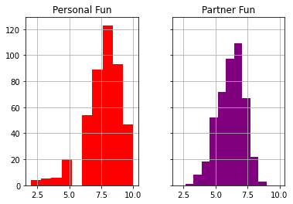
Fun Ratings
Key Takeaways
Matched participants rated themselves relatively high in fun and almost equally rated their partners the same
Unmatched participants rated themselves high in fun but rated their participants less so
Matched
Unmatched

Slide 9
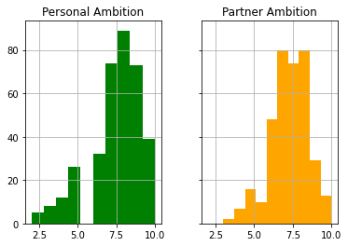
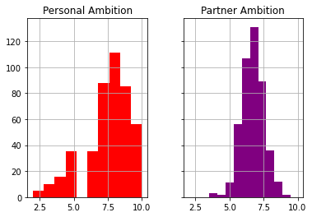
Ambition Ratings
Key Takeaways
Matched participants rated themselves relatively high in ambition but rated their partners in two groups of frequency, 8 and 7, resulting in a bimodal distribution
Unmatched participants also rated themselves high in ambition with the most frequency occurring at 7 and their partners rated slightly less at a high frequency of 6
Matched
Unmatched

Slide 10
Men vs Women: What are they looking for?
Question 2: How do men and women differ in how they rate the opposite sex and how they think the opposite sex rates them? Are there differences pre-speed-dating and post-speed-dating?
Summary:
Pre-Speed-Dating Men rate attractiveness as the highest quality in a partner.
Pre-Speed-Dating Women rate intelligence as the highest quality in a partner.
Sincerity, intelligence, fun, and shared interests are rated similarly and are stable pre- and post-speed-dating.
Post-Speed-Dating both men and women rate attractiveness as most important quality in a partner.

Slide 11
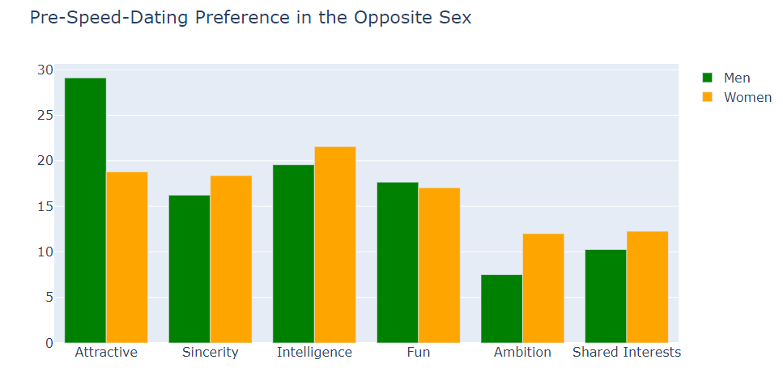
Key Takeaways:
Men value attractiveness above all other qualities.
Women value intelligence highest.
Both men and women value ambition the least.

Slide 12
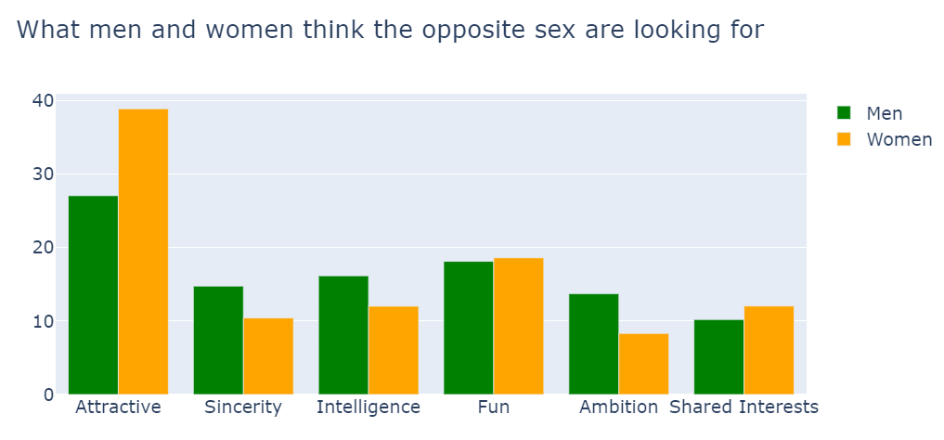
Women thought men valued attractiveness far higher
Men thought women valued ambition higher than they did.

Slide 13
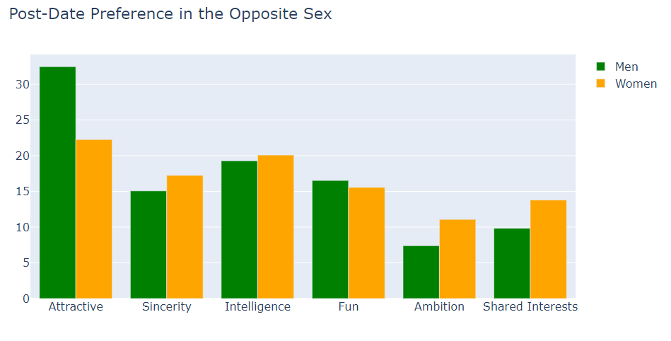
Key Takeaways:
Men and now women prefer attractiveness above all other qualities.
Both still prefer ambition the least.
All other attributes similar to pre-speed-dating.

Slide 14
Career Goal Attributes
Question 3: How do individual's Career Goal influence how they rate themselves vs how they were rated by their partners?
We could not conclude that a person’s intended career has any significant influence on how they rate their own attributes or how they were rated by their partner. On average the rates were between 7 and 8 when rating themselves and 6 and 7 when rating others. Because of this, we took the mean value of all the participant’s scores and looked closely on how they differentiate.
Attractiveness ratings were on the lower end.
Sincere/Intelligence ratings were on the higher end.
International Affairs had the highest overall score (sum of all averages)
Undecided Intended Careers had the lowest overall score.

Slide 15
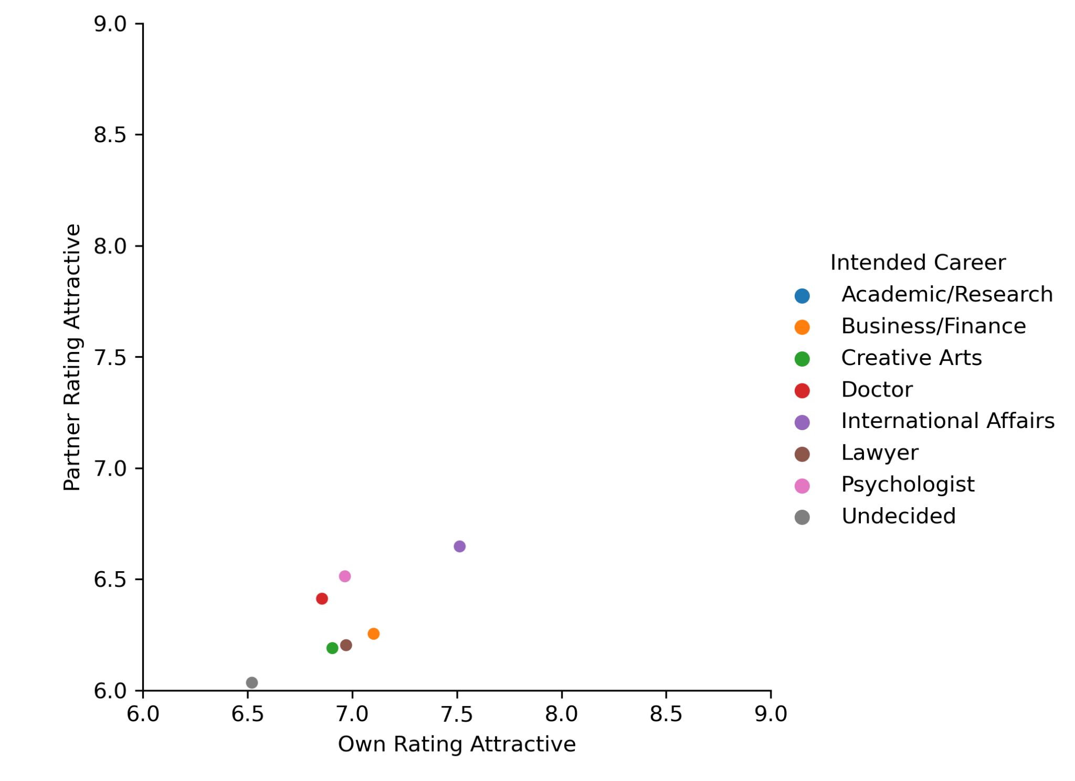
Attractive
Key Takeaways:
Those with Undecided career goals rate their attractiveness lower than any other group.
Those with International Affairs career goals rate their attractiveness higher than any other group.

Slide 16
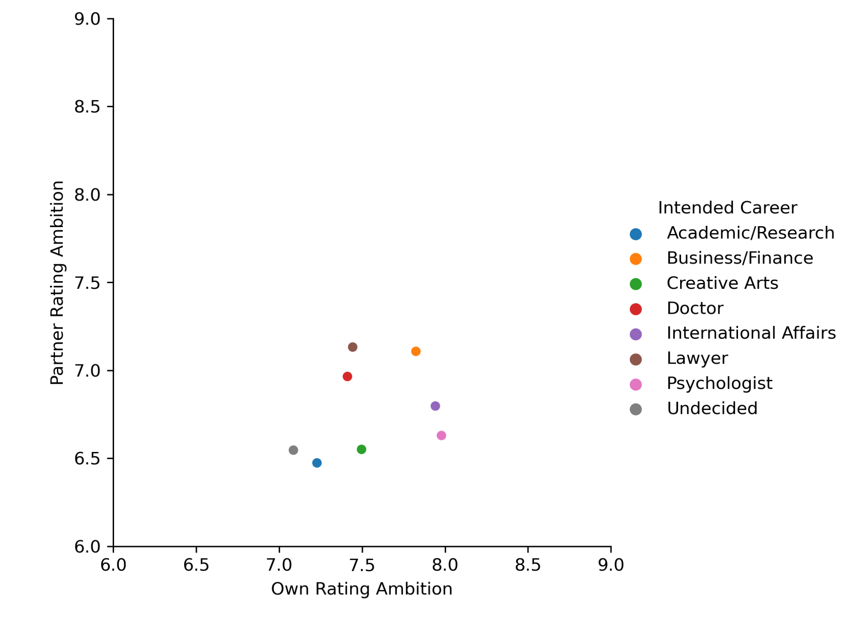
Ambition
Key Takeaways:
Those with Psychologist, International Affairs, and Business/Finance career goals find themselves most Ambitions.
Those with Academic/Research career goals were rated with the lowest Ambition.

Slide 17
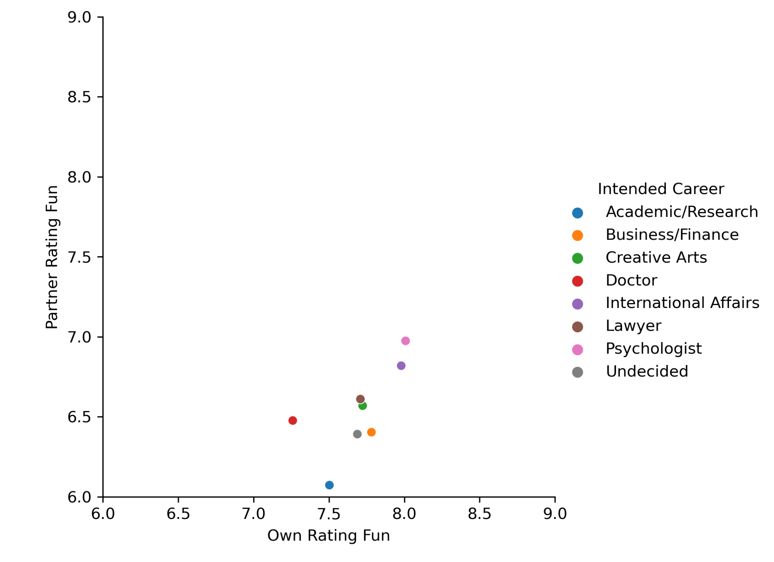
Fun
Key Takeaways:
Those with Psychologist, International Affairs, career goals rank themselves most Fun.
Those with Academic/Research goals were rated with the least Fun

Slide 18
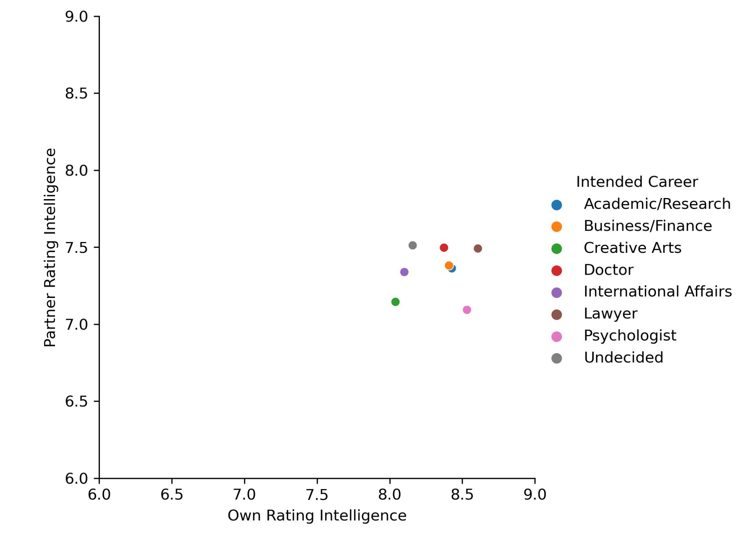
Intelligence
Key Takeaways:
All participants rank their Intelligence to be their strongest attribute.
The Intelligence rating is most consistent across all people both ranking themselves and rating others.

Slide 19
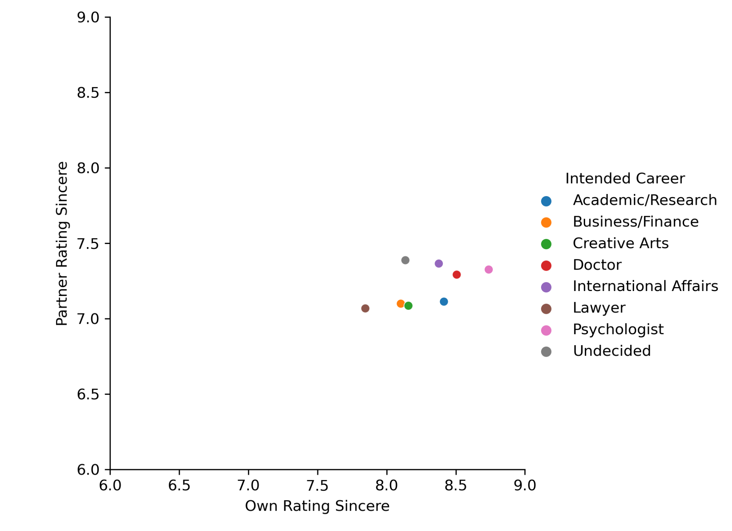
Sincere
Key Takeaways:
Those with Psychologist career goals find themselves most Sincere, making it by far the strongest attribute.
Those with Lawyer career goals rank themselves least Sincere

Slide 20
Matches and Partner Decisions per Intended Career
Question 4: How did an Intended Career impact the number of Positive Matches a participant received in Speed Dating? Were the Partner Decisions impacted?
Based on the results, we cannot conclude that a participant’s Intended Career had a significant impact on the number or percentage of positive matches one would receive. This held true for Partner Decisions as well. Using the data to find the total number of positive matches and decisions, we then calculated the percentages of each as well. Total numbers were found to be an indication of the number of participants per intended career rather than the careers that received higher positive match rates.
Summary:
Psychologists and Lawyers will find their match speed dating more than other intended careers.
But if you are just looking for positive affirmations without matching Doctor or International Affairs is for you.

Slide 21
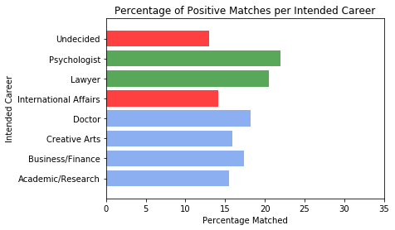
Top Careers for Finding Your Match
Key Takeaways:
Best careers to increase speed dating match rate:
Psychologist
Lawyer
Best careers to reduce speed dating match rate:
Being Undecided
International Affairs

Slide 22
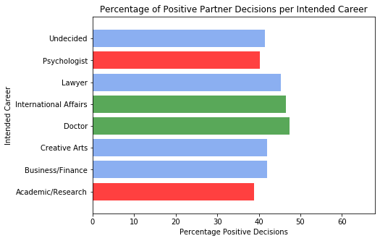
But Did My Partner Like Me?
Key Takeaways:
Although the percentage points are all rather close, an Intended Career in Medicine received the highest amount of Positive Partner Decisions, with Academic Research trailing behind.

Slide 23
Cleaning the Data
We dropped 20 participants because their rating system was different from the rest (not using a ranking 1-10)
When grouping by Intended Career, we dropped entries below the 50% percentile.

Slide 24
Post Analysis Thoughts
Difficulties that arose:
The overall size of the data was not large enough to gather large enough samples sizes by subgroups within the data, leading to dropping categories (example, Intended Career).
Creating Scatterplots with this data was challenging, often resulting in grid square visual results. By grouping and gathering the means of data, we were able to create better visuals.

